Slide 1

Team 13:Optimizing Multicore Process Scheduling for Efficiency in Operating Systems
CSA0496 | Operating Systems for Segmentation
Suthesan vj kavinkumar e Surya Karthik
192210542 192224243 192221108

Slide 2

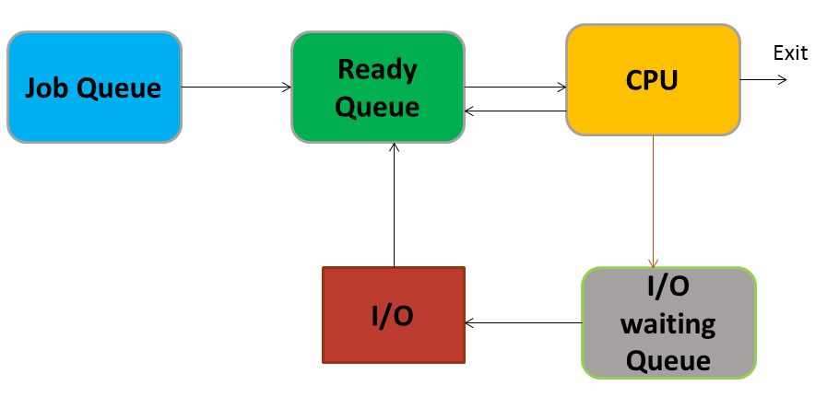
OBJECTIVE
The objective of "Optimizing Multicore Process Scheduling for Efficiency in
Operating Systems" is to enhance overall system performance by developing
and implementing advanced scheduling algorithms. These algorithms aim to
efficiently distribute tasks across multiple processor cores, maximizing core
utilization, minimizing latency, and balancing workloads to prevent uneven
resource usage. Additionally, the optimization effort considers energy
efficiency, adaptability to dynamic workloads, and scalability to accommodate
an increasing number of processor cores. The ultimate goal is to improve the
responsiveness and efficiency of operating systems, ensuring optimal
utilization of multicore architectures while maintaining compatibility with
existing applications and systems.

Slide 3

INTRODUCTION
In the ever-evolving realm of computing, the proliferation of multicore processors has opened new horizons for system performance, with the promise of parallel execution capabilities. Central to unlocking this potential is the optimization of multicore process scheduling within operating systems. This entails a meticulous exploration of scheduling algorithms, resource management, and synchronization techniques to efficiently allocate CPU resources across multiple cores. As we navigate this landscape, the transition from single-core to multicore architectures introduces both challenges and opportunities, requiring innovative strategies for workload distribution. This investigation seeks to unravel the complexities of balancing tasks, minimizing contention, and maximizing throughput, contributing to the ongoing discourse on shaping responsive and efficient computing experiences in the era of multicore dominance.

Slide 4
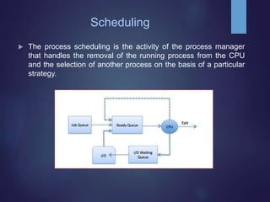
Fundamentals of Multicore Process Scheduling
Parallelism and Concurrency: Understanding the principles of parallelism and concurrency is fundamental to optimizing multicore scheduling. This section will delve into the challenges and opportunities posed by these concepts in the context of operating system scheduling.
Types of Multicore Architectures: Explore different multicore architectures and their implications for scheduling. This includes symmetric multiprocessing (SMP), asymmetric multiprocessing (AMP), and heterogeneous multicore architectures.

Slide 5
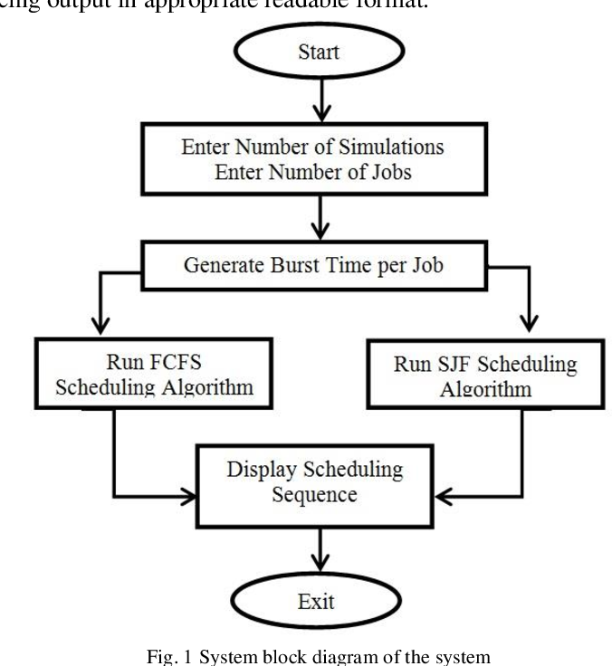
Traditional Scheduling Algorithms
Round Robin Scheduling: Analyze the effectiveness of traditional scheduling algorithms such as round-robin in the context of multicore systems. Discuss the limitations and areas for improvement.
Priority-Based Scheduling: Investigate the adaptation of priority-based scheduling to multicore environments. Explore the challenges of maintaining fairness and avoiding priority inversion.
Real-Time Scheduling: Assess real-time scheduling algorithms and their applicability to multicore systems. Address the trade-offs between meeting deadlines and maximizing resource utilization.

Slide 6
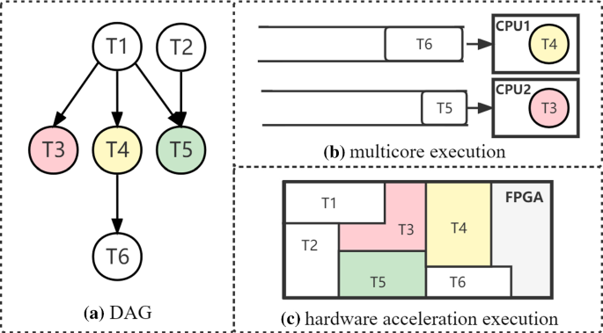
Advanced Multicore Scheduling Algorithms
Load Balancing Techniques: Survey load balancing strategies designed to distribute tasks evenly across cores, minimizing idle times and maximizing overall system throughput.
Thread Migration: Explore the concept of thread migration and its impact on efficiency. Discuss techniques for dynamically relocating threads among cores to optimize performance.
Machine Learning-Based Approaches: Investigate the use of machine learning algorithms for predicting task behavior and optimizing process scheduling dynamically based on historical data.

Slide 7
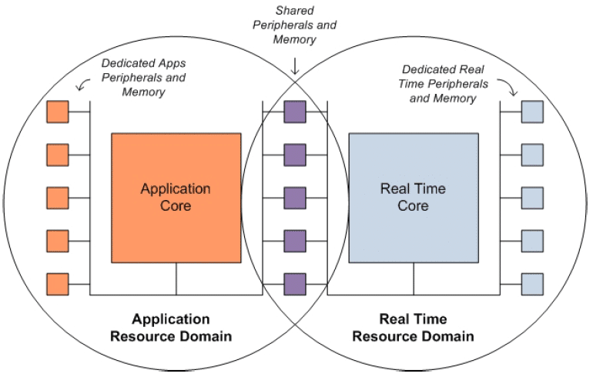
Heterogeneous Multicore Systems
Challenges and Opportunities: Analyze the unique challenges posed by heterogeneous multicore architectures. Discuss how scheduling algorithms need to adapt to diverse core capabilities and characteristics.
Task Mapping Strategies: Explore approaches for mapping tasks to specific cores in heterogeneous systems, considering factors such as power consumption, computational capacity, and memory access speeds.

Slide 8
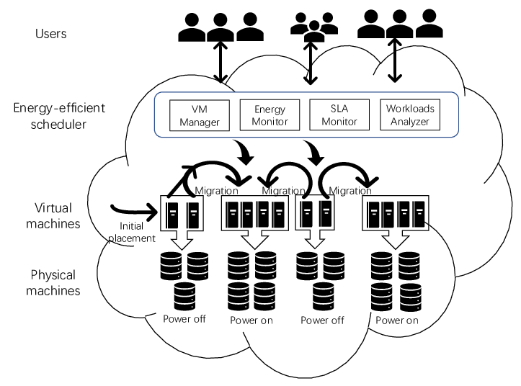
Energy-Efficient Scheduling
Dynamic Voltage and Frequency Scaling (DVFS): Investigate the integration of DVFS techniques into multicore scheduling to optimize energy consumption without compromising performance.
Power-Aware Scheduling Algorithms: Review algorithms designed explicitly to minimize power consumption in multicore systems while maintaining acceptable levels of performance.

Slide 9

Thank You

